Slide 1

Kyle Crouse, Zach Lee, Austin Ricks, Zeke Zumbro

Slide 2
OUTLINE
Problem Statement
Specifications
Timeline
Design Details
Budget
Test Plan
Demonstration
Results

Slide 3
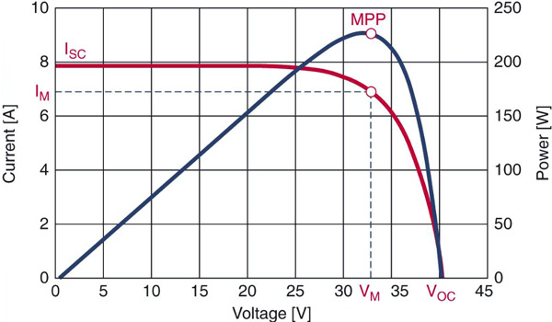
Project: Maximum Power Point Tracker
Problem Statement
MPPT increase the power output of PV panels, however due to the high costs of many on the market they are not economically viable for small solar arrays; this creates a need for a lower cost option.
Why?
A solar panel does not produce the maximum possible power output when connected directly to a battery.
Notes:
Explain I-V graph:
Point out that current is on one axis and voltage is on another axis, thus power increases as you approach the top right corner

Slide 4

Specifications
Technical Criteria
 | Min | Max
V_{in} | 5 V | 38 V
V_{out}* | 0 V | 25 V
∆V_{out} | - | 2.5%
P | - | 300 W
∆P | +10% | -
Efficiency | 85% | -
Self-Consumption | - | 50 mW
Length | - | 8"
Width | - | 6"
Height | - | 4"
Revised Criteria
Min | Max
5 V | 40 V
0 V | 25 V
- | N/A
- | 100 W
+10% | -
70% | -
- | 100 mW
- | 8"
- | 6"
- | 4"
Actual
Min | Max
5 V | 40 V
0 V | 25 V
- | N/A
- | 65 W
+35% | -
75% | -
- | 64 mW
- | 4.5"
- | 3.5"
- | 2"
Constraints
Production cost must not exceed $75
Prototype cost must not exceed $150
Prototype must be weather resistant
Design must prevent electric shock to users
Notes:
Important Technical Criteria to hit:
Vin (looking for flexibility)
Vout (expecting a battery rated at 12 V)
Efficiency
Self-consumption (important for efficiency)

Slide 5
Timeline
Beginning of Junior Design
Design Review1
Design Review 3
Jan 15
Feb 17
Apr 16
Project Perposal
Design Review 2
Presentation & Report
Feb 19
Apr 2
May 5
January
February
March
April
May
Research
Thu 1/15/15
Fri 2/27/15
Electrical Design
Sat 2/28/15
Tues 4/7/15
Mechanical Design
Sat 2/28/15
Tues 4/7/15
TroubleShooting
Wed 4/1/15
Tue 4/21/15
Assembly
Wed 4/22/15
Tues 4/28/15
Testing
Wed 4/22/15
Tues 5/5/15
Documentation
Sat 2/28/15
Tues 5/5/15

Slide 6
Design Details: Circuit Schematic

Slide 7
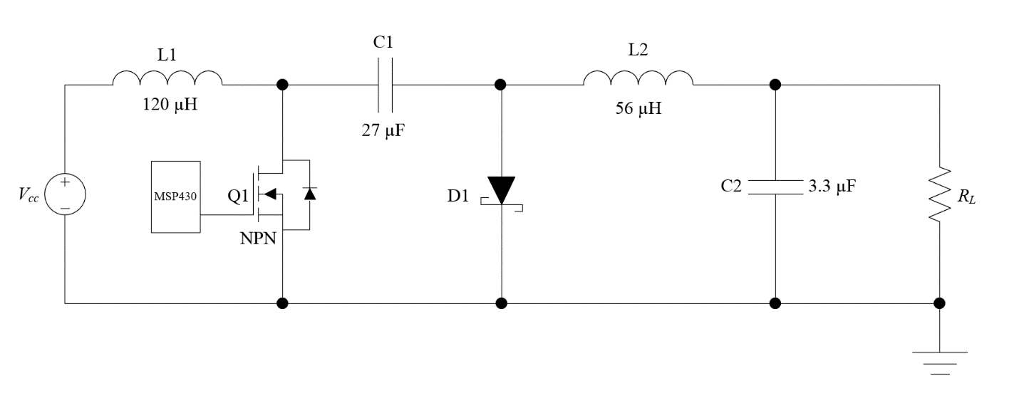
Design Details: Ćuk Converter

Slide 8
Design details: sensors
Voltage Divider with OP-AMP Buffer
Inverting Amplifer Configuration
Shunt Resistor Configuration

Slide 9
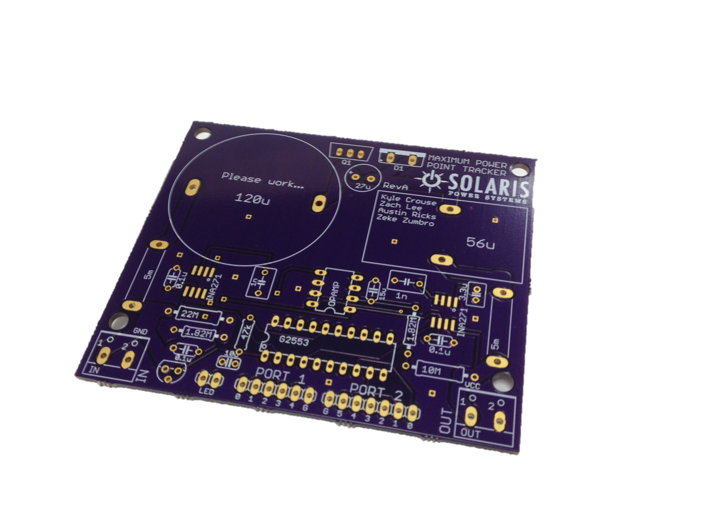
Design Details: Printed Circuit Board
Board Layout
Trace Widths

Slide 10
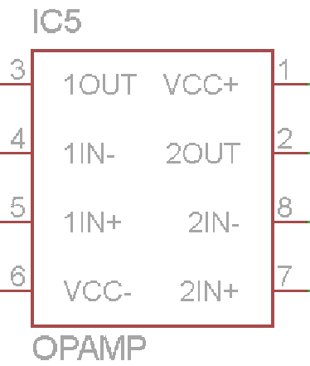
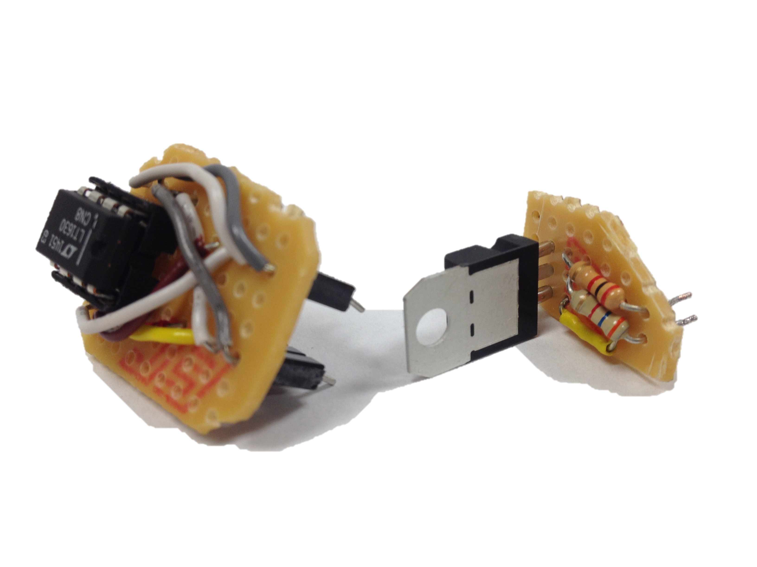
Design Details: Troubleshooting
Stamps
Fixed Operational Amplifier
Linear Regulator Replacement

Slide 11
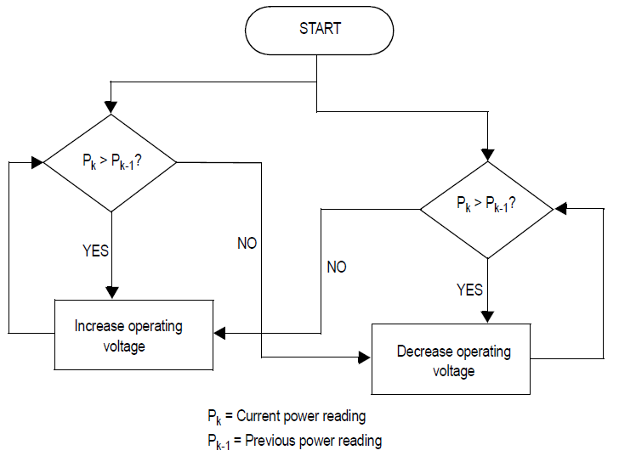
Design Details: Algorithm
Perturb and Observe Algorithm

Slide 12
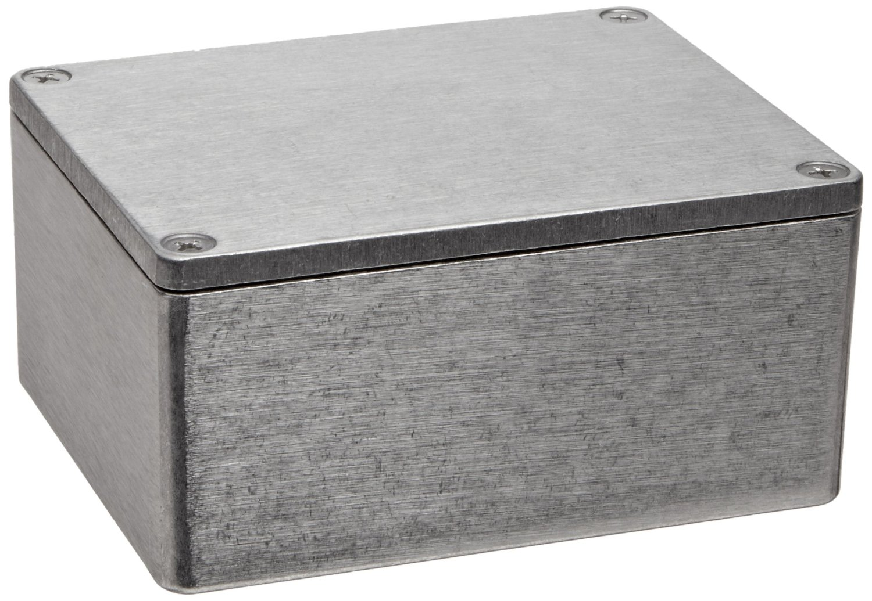
Design Details: Lil’ Bricky
Die-Cast Aluminum Alloy
Weather-Proof
Heat Disappating
Durable

Slide 13
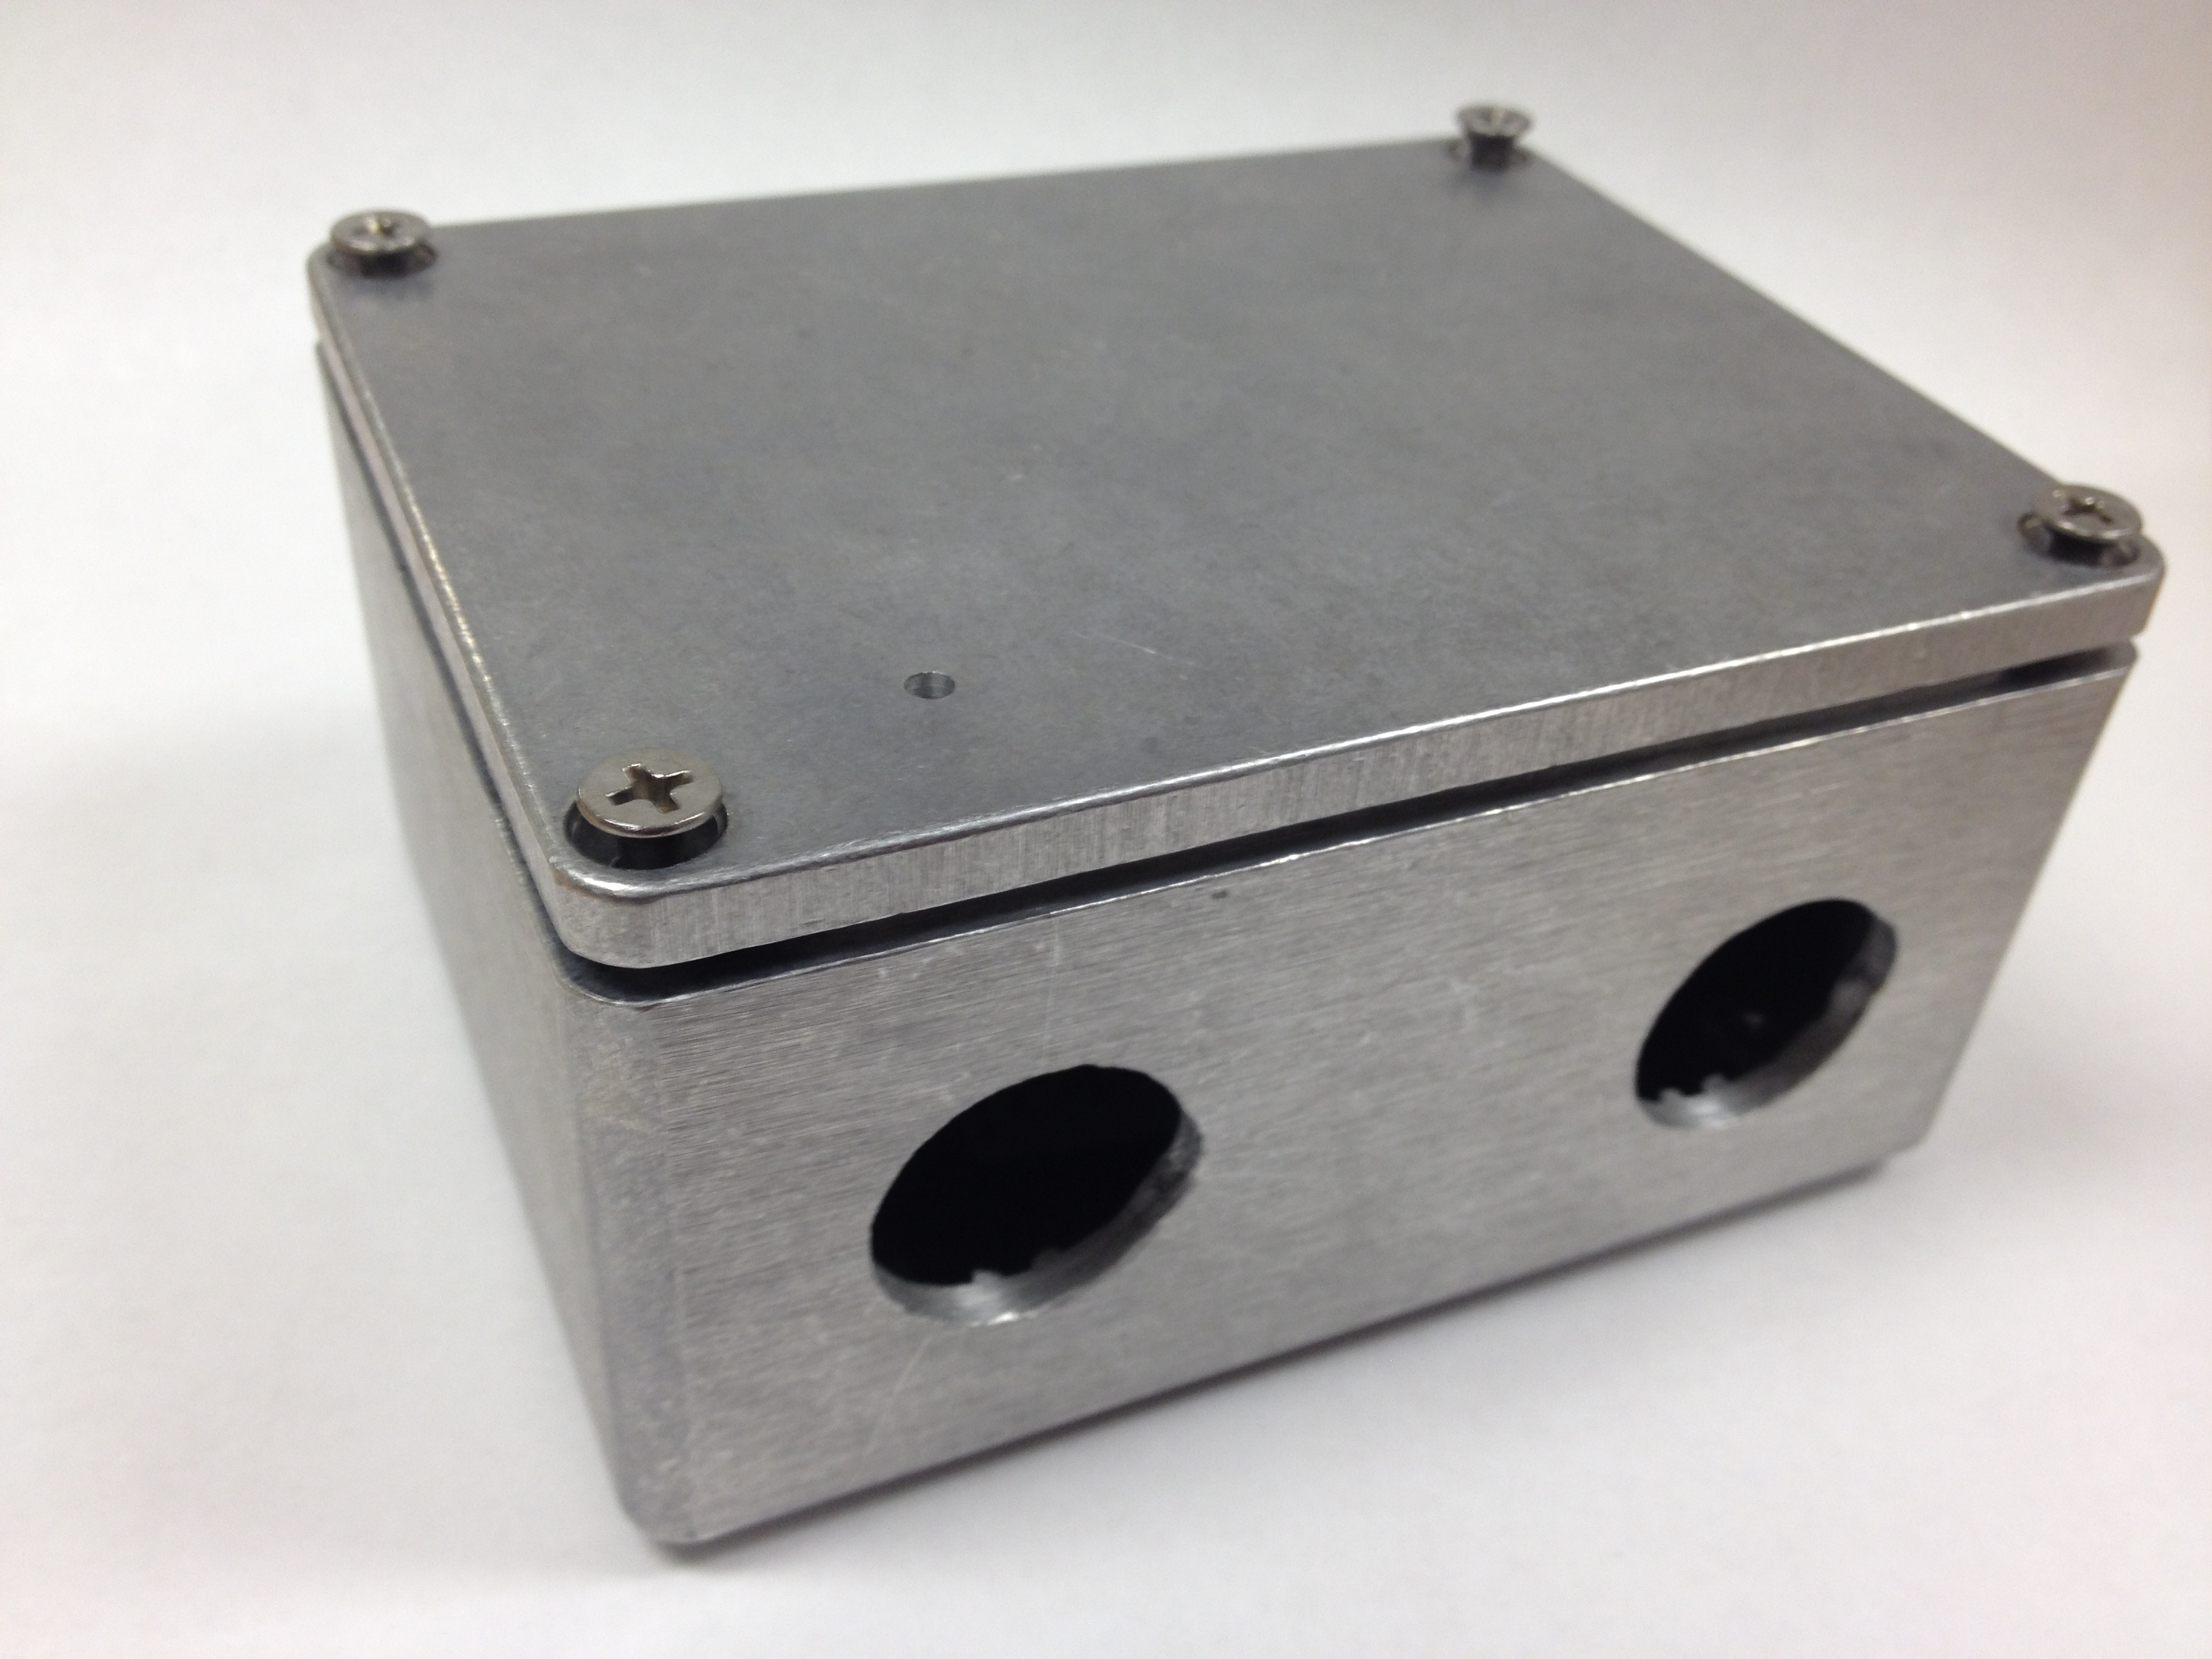
Design Details: Lil’ Bricky

Slide 14
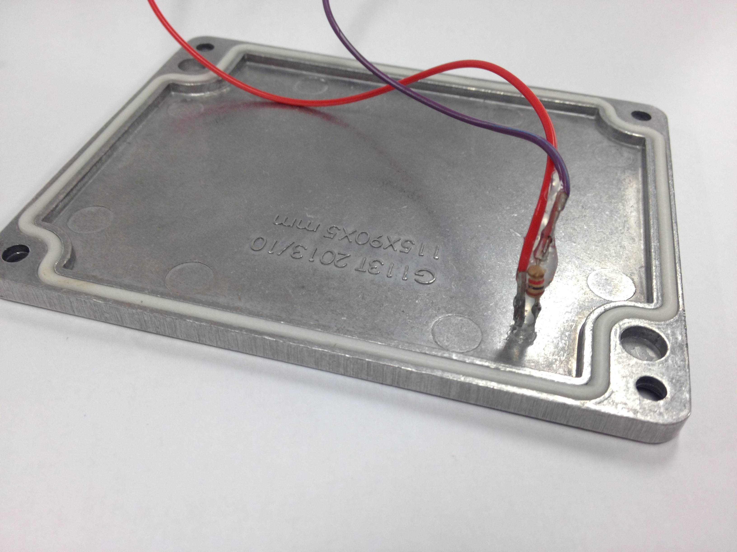
Design Details: Lil’ Bricky

Slide 15
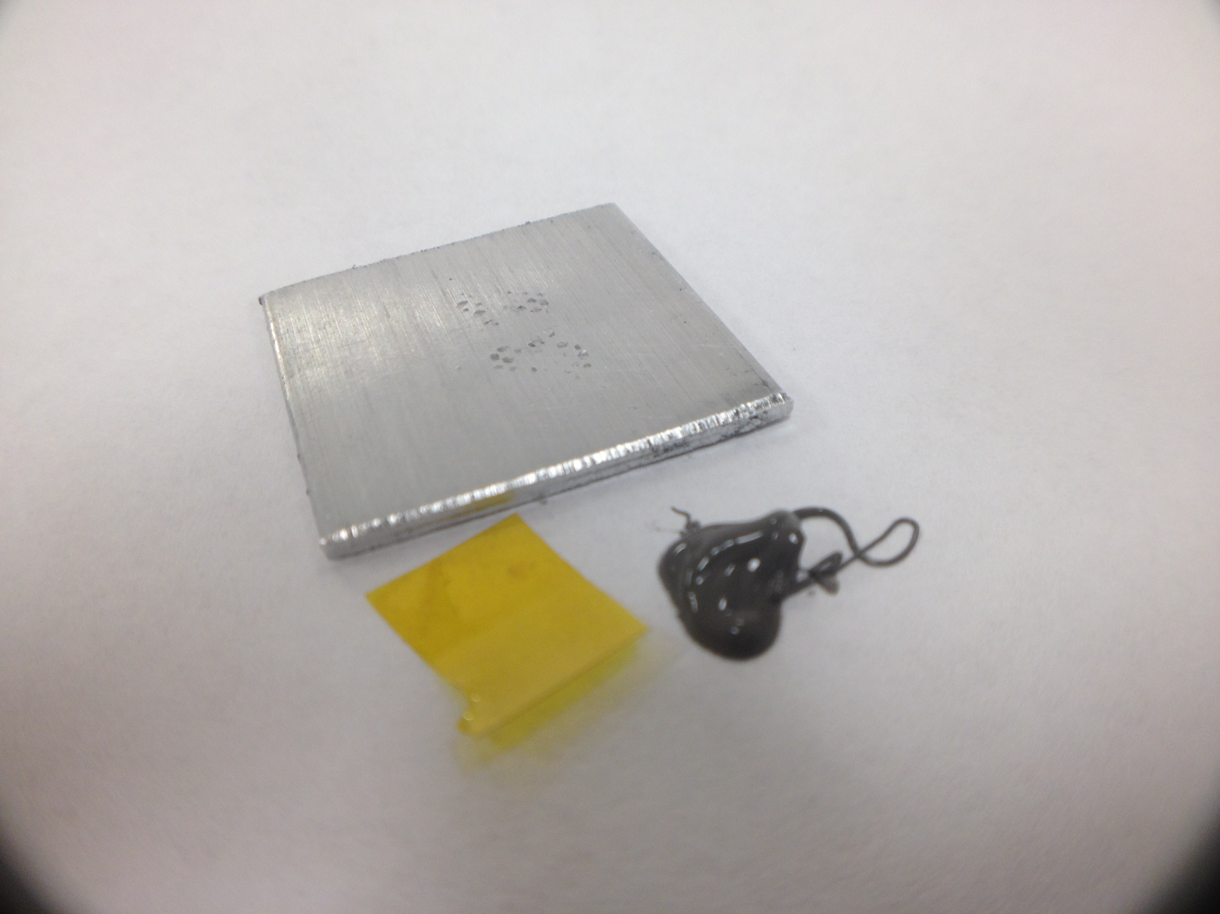
Design Details: Lil’ Bricky

Slide 16
BUDGet
Income: $750
Junior Design Budget: $150
SURF Grant: $600
Expenses: $198.78
Electrical Components: $146.02
Mechanical Components: $40.21
Packaging: $5.38
Shipping: $7.17
Excess: $551.22
Prototyping Cost: $91.32 (Goal was < $150)
Production Cost: $40.66 (Goal was < $75)

Slide 17
Test Plan
Subsystem Tests
DC-DC Converter
Verification
Sensors
Proper Voltage and Current measurements
Housing
Weather testing
Integrated Testing with PV Panels
Determine overall power increase
Determine overall power consumption

Slide 18
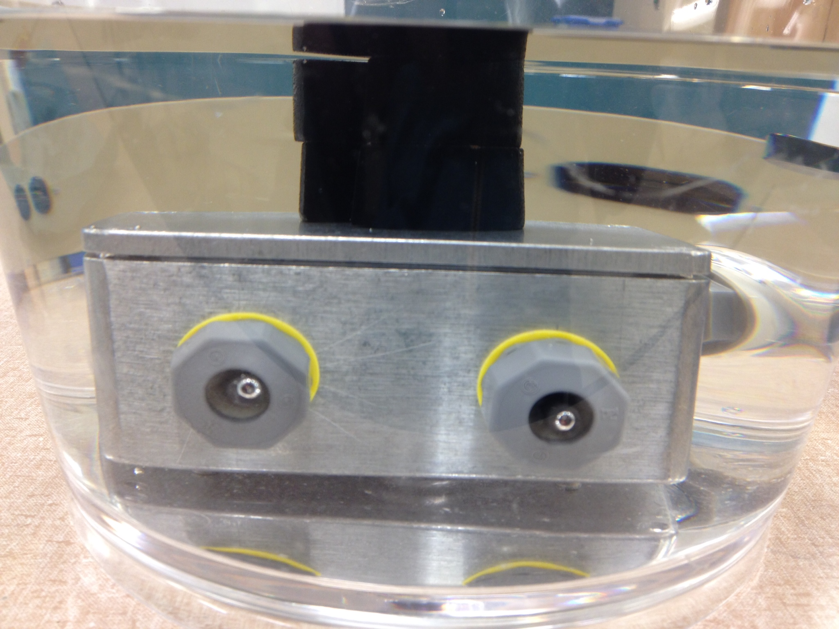
Mechanical Results

Slide 19
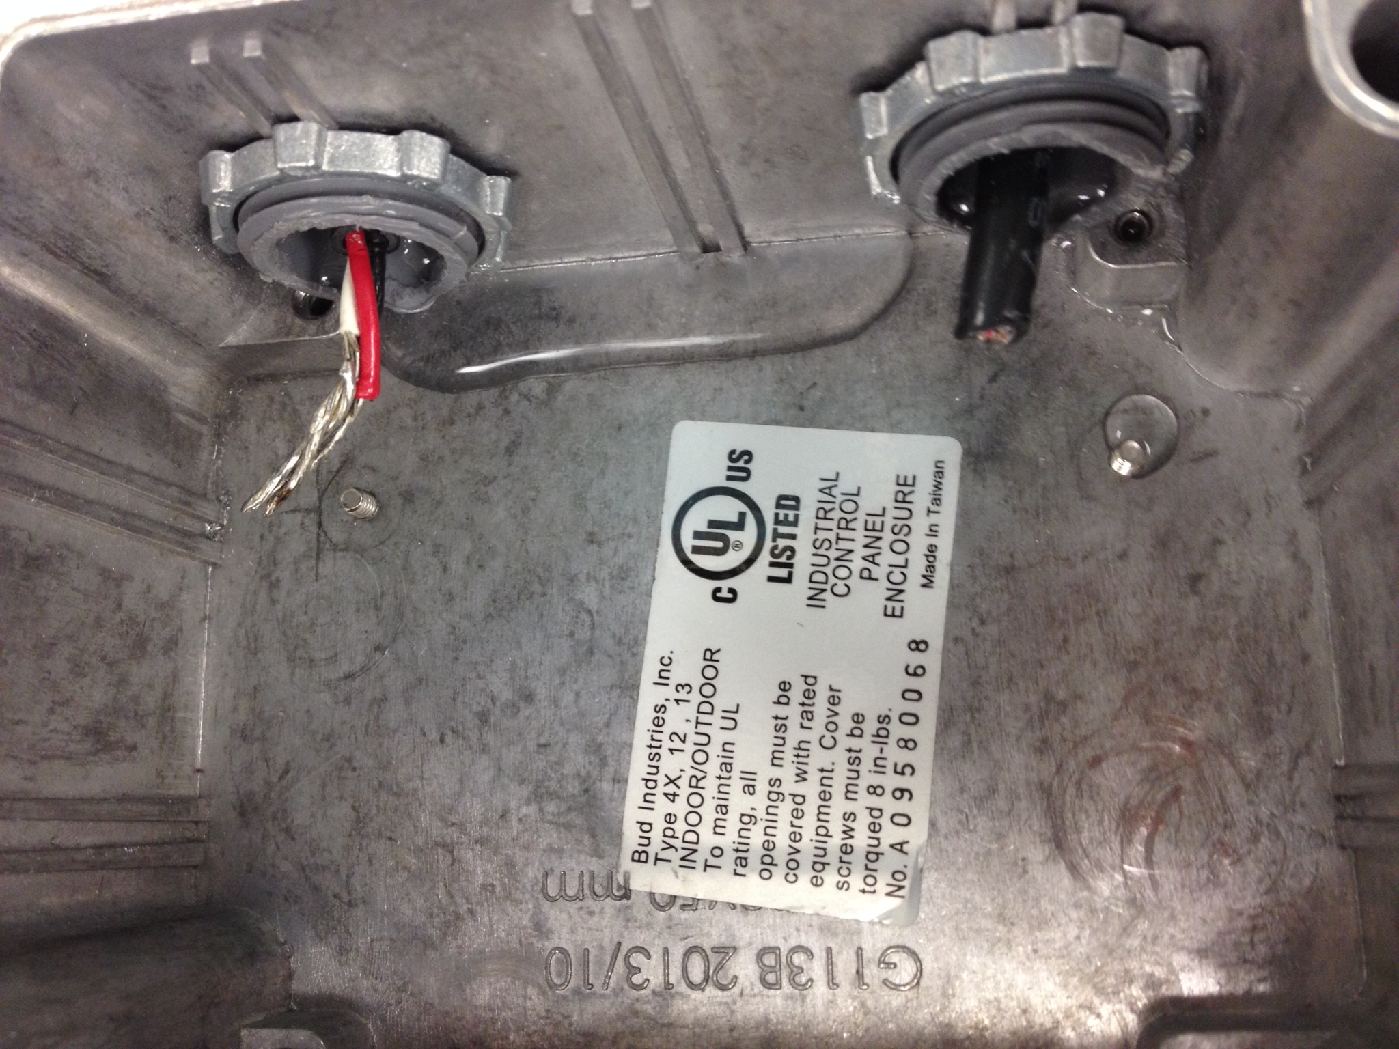
Mechanical Results

Slide 20
Mechanical Results

Slide 21
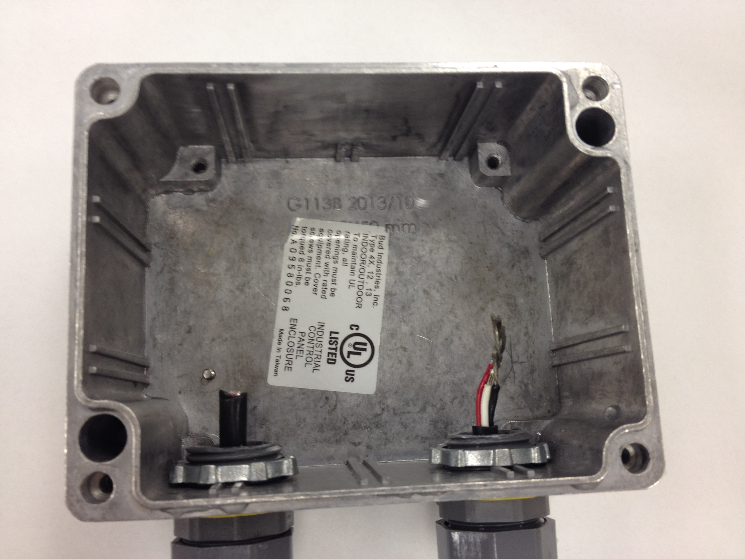
Mechanical Results

Slide 22
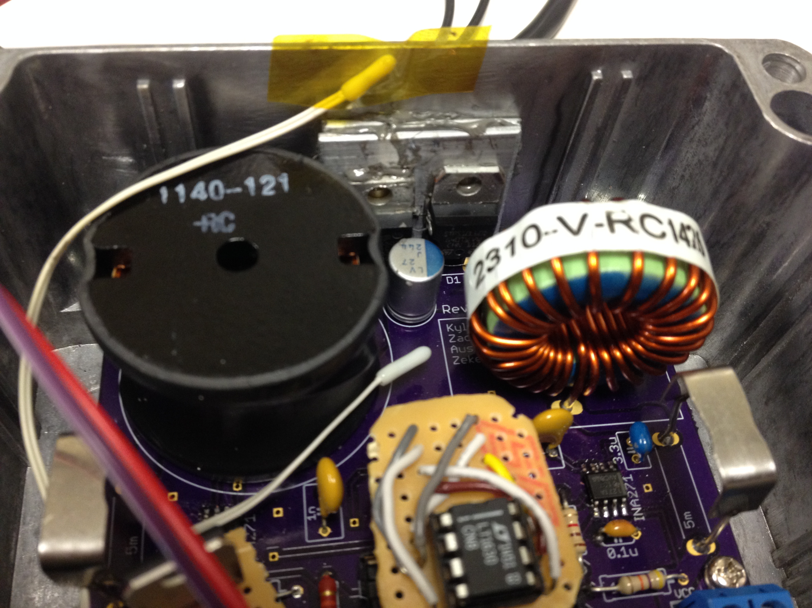
Mechanical Results

Slide 23
Mechanical Results

Slide 24
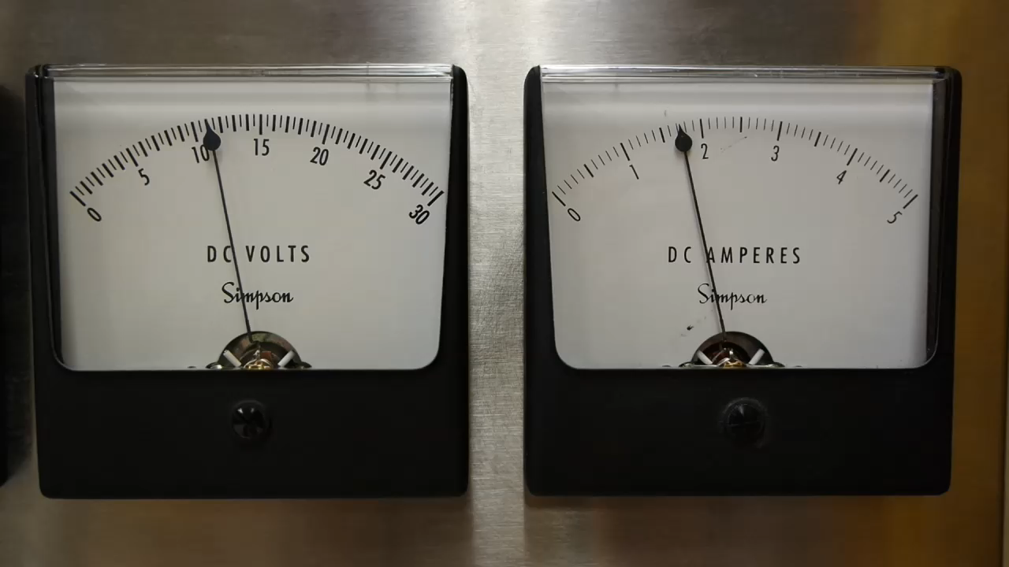
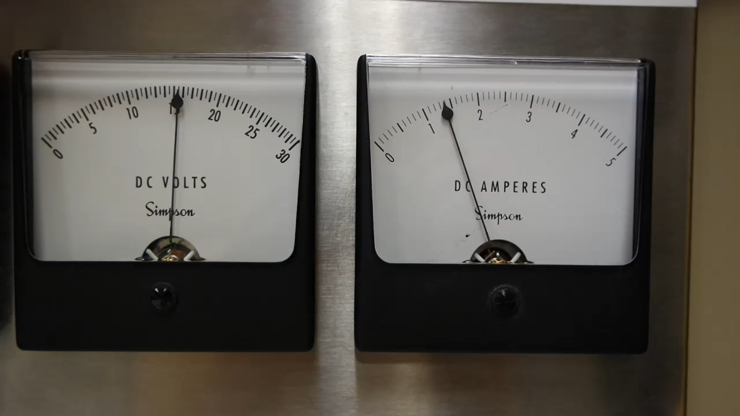
demonstration
Resistor 6 Ω
MPPT with 6 Ω

Slide 25
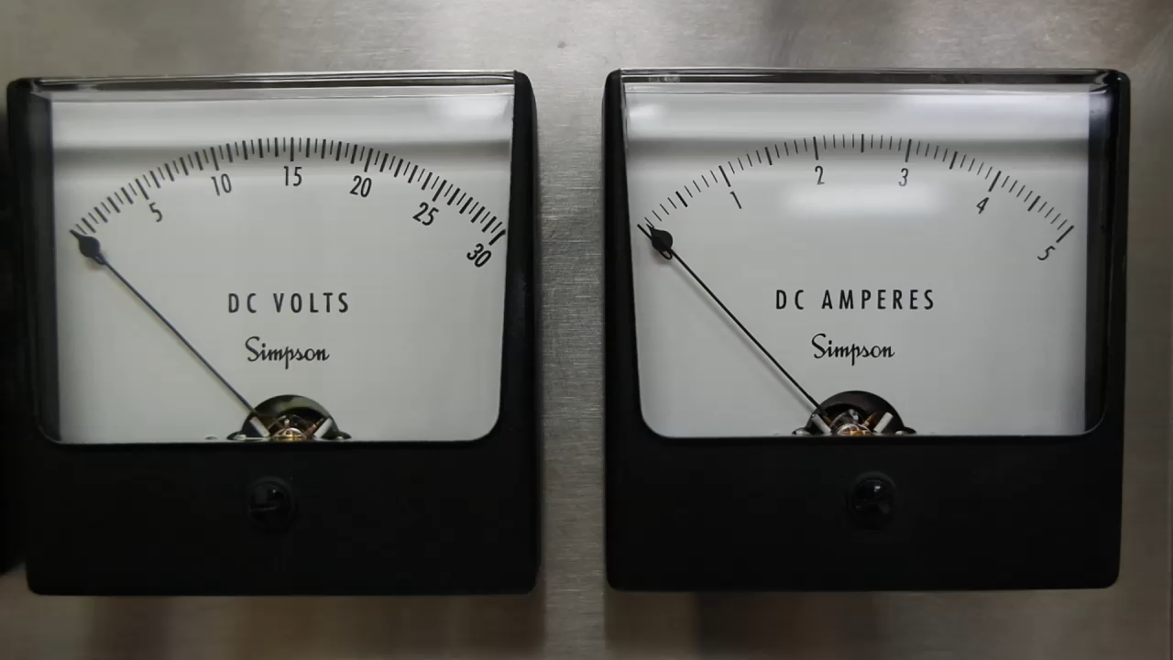
Demonstration

Slide 26
Electrical Results
∆P of +35.24%
Efficiency of 75%

Slide 27
Questions?

